Slide 1

Lesson #1 What is AI?

Slide 2
introductions
Your facilitators: Name & Name

Slide 3
Share your name and your favorite animal

Slide 4
Write as many terms as you can remember from Level 1

Slide 5
What is AI?

Slide 6

Artificial intelligence
A computer system that mimics human intelligence by performing tasks such as:
Understanding language
Recognizing patterns
Making decisions
Definition from Code.org

Slide 7
Types of Artificial intelligence
There are many different types of AI
One of the most common types is called machine learning
Artificial Intelligence

Slide 8
Machine learning
We can collect a lot of information about how the world works (called data)
We can use this data to make predictions about what will happen in the future.
We call the process of teaching the computer patterns based on data "training".

Slide 9
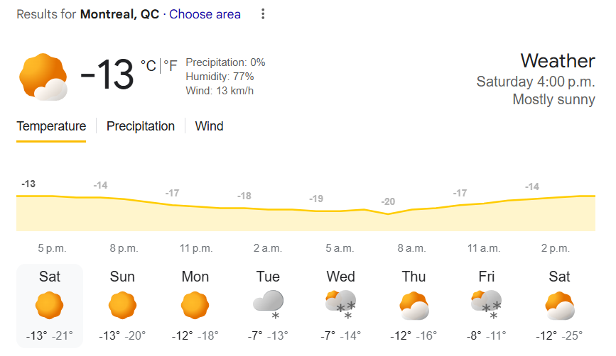
Machine learning
Example: Every day we collect data about the temperature outside. We can use past temperature data to predict what the temperature will be like tomorrow

Slide 10
Types of Artificial intelligence
Machine learning has been around for a long time.
One type of machine learning that has been growing quickly recently is large language models (LLMs).
Artificial Intelligence
Machine Learning

Slide 11

Large language models (llms)
In the last example, we made our prediction based on a specific set of data.
What if we made our prediction based on a really big amount text we can get (books, articles, social media, transcripts of YouTube videos)?

Slide 12

Large language models (llms)
We call this a Large Language Model (LLM). LLMs are a general form of AI trained on large body of knowledge
Can you think of examples of LLMs that you have used before?
ThePhoto by PhotoAuthor is licensed under CCYYSA
Definition from Code.org

Slide 13
Types of Artificial intelligence
Artificial Intelligence
That said, LLMs aren't the only type of AI.
We will be learning about some of them in the next couple of months.
We will also be using our Python skills to help us.
Machine Learning
Large Language Models

Slide 14
Setting up google Colab

Slide 15
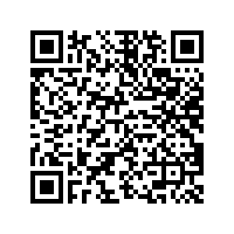
Open the QR code to open the workbook
Make your own copy of the workbook
File > Save a copy in Drive
Start working through the problems in the workbook to review our Python skills
https://colab.research.google.com/drive/1xQlCNpeagEfjNadbbW8O50jkwvVYPhHQ?usp=sharing

Slide 16
Read through the workbook and follow the instructions
If you need help:
Try Googling an example of the concept
E.g. "Variable Example in Python"
Ask a friend

